Slide 1
Overview of the Reclassification Process

Slide 2
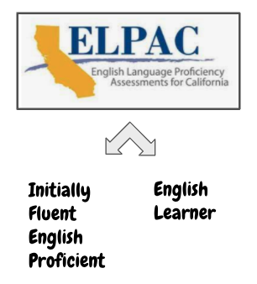
Identifying Potential English Learners (ELs)
Step 1
Review the Home Language Survey
Step 2
Assess Potential EL With the Initial ELPAC
Step 3
Program Placement
•EL Programs and Services

Slide 3
EL Programs and Services
We have the dual obligations to not only provide programs that enable EL students to attain English proficiency, but also to provide support in other curricular areas that will ensure ELs have equal opportunities to participate in the curriculum.
Meaningful access to the core curriculum
attain English proficiency
within a reasonable length of time

Slide 4
Monitoring the Progress of English Learners (ELs)
SAUSD must monitor the progress of all ELs in achieving English language proficiency (ELP) and in acquiring content knowledge to determine when students are not making appropriate progress, and provide additional support to enable ELs to reach English proficiency and gain grade-level content knowledge. This will ensure ELs are provided meaningful access to grade-level core content instruction and remedying any academic deficits in a timely manner.
In addition, schools continually monitor students’ progress and adjust instructional strategies to target and support students’ needs via their SPSA EL goals.

Slide 5
Exiting English Learners From EL Programs and Services
Reclassification
Reclassification is the process whereby a student is reclassified from EL status to Fluent English Proficient (RFEP) status upon meeting a set criteria.
English Learner (EL) Reclassified Fluent English Proficient (RFEP).
Notes:
LEAs must monitor the progress of all ELs in
achieving English language proficiency (ELP)
and in acquiring content knowledge.
• LEAs should establish rigorous monitoring
systems that include benchmarks for expected
growth and take appropriate steps to assist
students who are not adequately progressing
towards those goals.
• SEAs must monitor LEAs to ensure that they
are providing ELs meaningful access to grade­
level core content instruction and remedying
any academic deficits in a timely manner

Slide 6
Criterion 1: Assessment of Language Proficiency
We must conduct an annual ELP assessment - Summative ELPAC
ELPAC Overall Performance Level: 4 (Set by State Board of Education)
Opinion y consulta con los padres
Comparación del desempeño estudiantil en habilidades básicas
Notes:
The ELPAC Overall Performance Level (PL) 4 was approved by the State Board of Education as the statewide standardized ELP criterion (1). LEAs shall use ELPAC Overall PL 4 to determine whether a student has met that criterion.

Slide 7
Criterion 2: Teacher Evaluation
Teacher evaluations, including, but not limited to, a review of the pupil's curriculum mastery:
Sample Evidence of Academic Performance:
Evaluation of student use of English
Language practices - classwork samples
Performance in content learning
Teacher observations
Formative Assessments
Criterion locally determined
Comparación del desempeño estudiantil en habilidades básicas

Slide 8
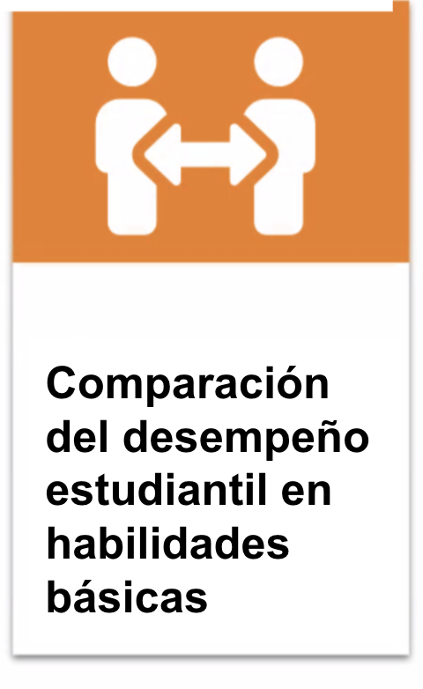
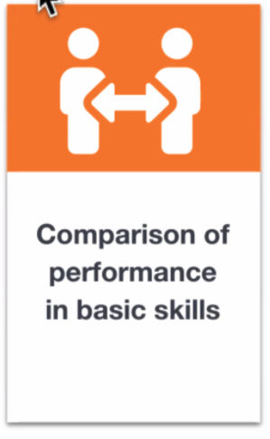
Criterion 4: Comparison of Performance in Basic Skills
Comparison of the performance of the pupil in basic skills against an empirically established range of performance in basic skills based upon the performance of English proficient pupils of the same age, which demonstrates whether the pupil is sufficiently proficient in English to participate effectively in a curriculum designed for pupils of the same age whose native language is English.
Criterion locally determined
Evaluación del dominio del idioma inglés
Grades | Assessment
K-3 | DIBELS MAP/Reading
3-12 | DIBELS - 3rd grade MAP/Reading CAASPP/SBAC SAT/ PSAT
Opinion y consulta con los padres
Comparación del desempeño estudiantil en habilidades básicas

Slide 9
Criterion 3: Parent Consultation
Connect with families of English Learners to share student performance, discuss goals, and address parent concerns through consultation with parents.
Criterion locally determined
Evaluación del dominio del idioma inglés
Evalución del docente
Opinion y consulta con los padres
Comparación del desempeño estudiantil en habilidades básicas

Slide 10
Monitoring After Reclassification
Students exiting from EL status must be monitored for at least four years, to ensure that
(1) they have not been prematurely exited; and (2) they are meaningfully participating in the standard program of instruction comparable to their never-­EL peers.

Slide 11
Comments/Questions
Please contact SAUSD EL Programs
714 558-5855

